Slide 1
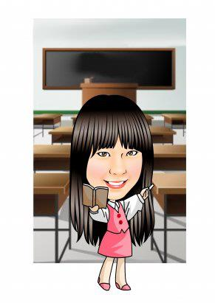
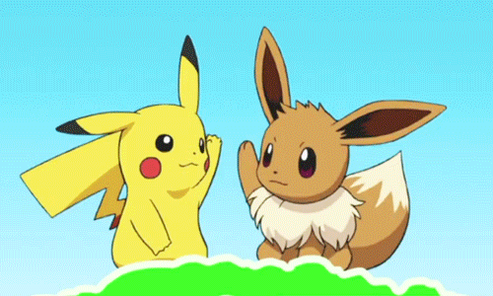
Hello, everyone!
I’m your English teacher.
My name is ________
?????

Slide 2
Listen! What is teacher’s name?

Slide 3
Are you right?
My name is Mandy.
You can call me Teacher Mandy.

Slide 4
When you hear “Mandy”, you can clap your hands.

Slide 5
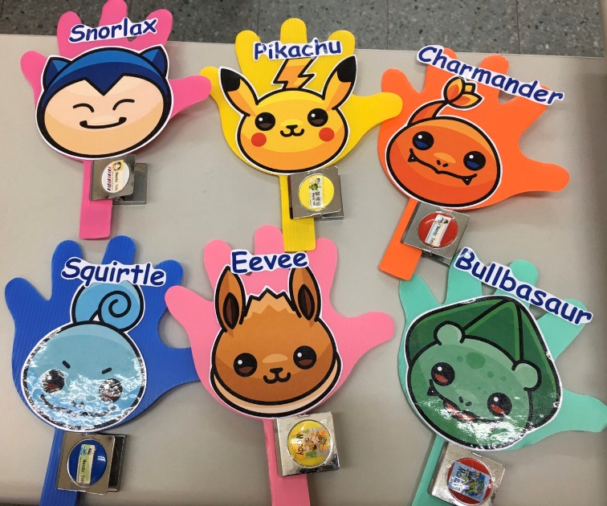
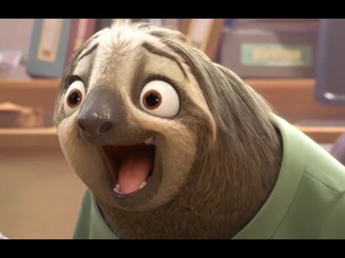
Teacher Mandy’s Classroom Rules
6 groups
Winner can get stamps
Break the rules.
No stamp!

Slide 6
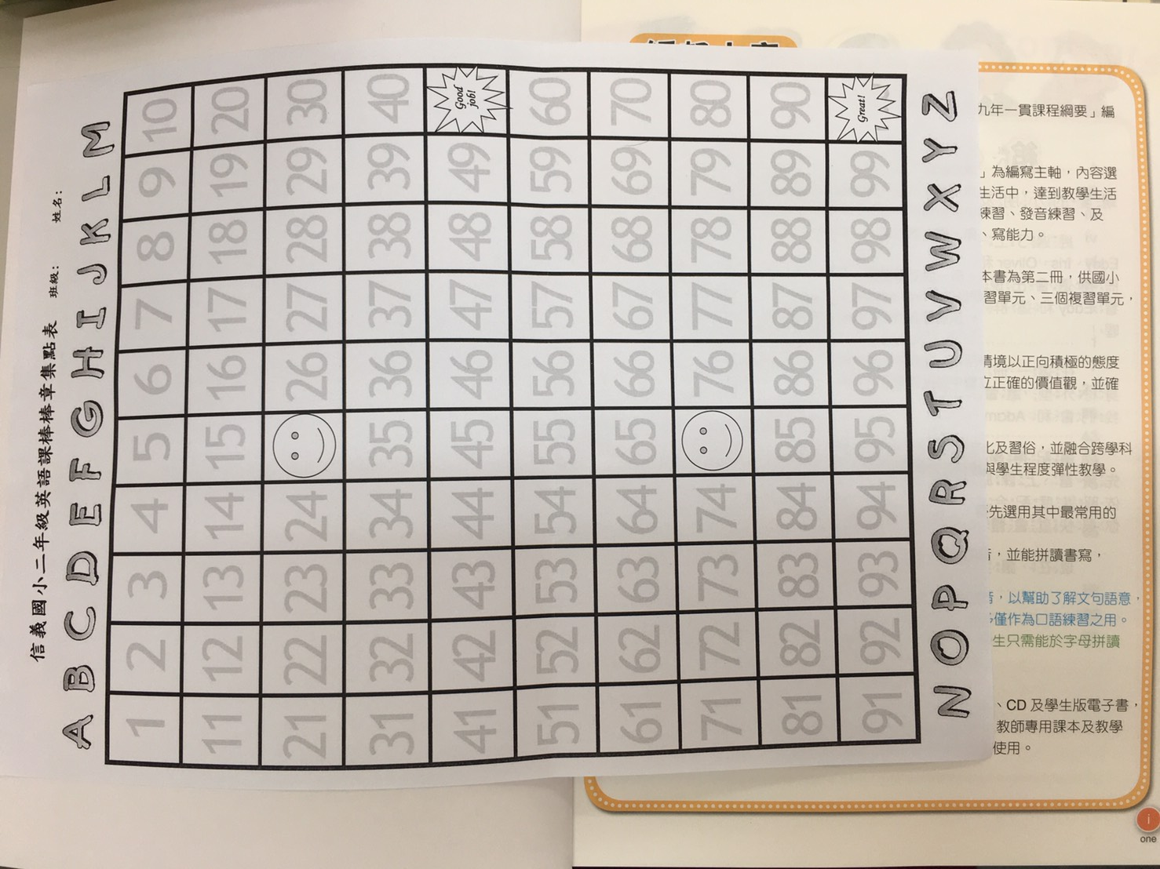
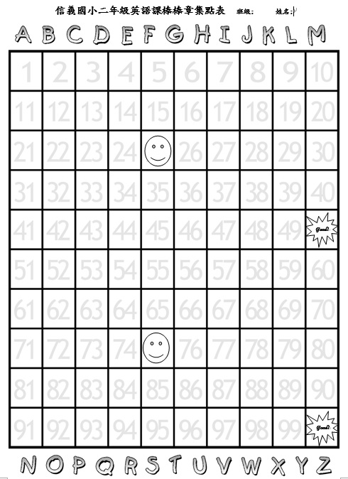
英語課的棒棒章集點表

Slide 7
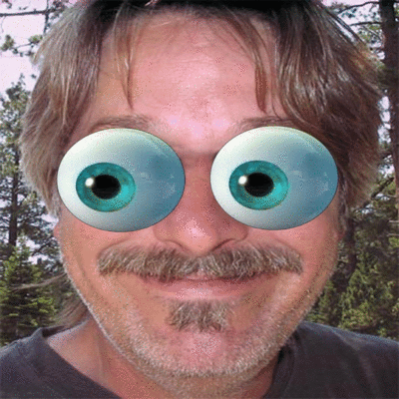
默契口號練習!
Teacher Mandy: One, two, three.
Eyes on me.
Students: One, two.
Eyes on you!

Slide 8
Write down your name.
Class: 203/204
Number: 座號
Name:中文姓名+英文姓名
Teacher: Mandy

Slide 9
Write down your name
Class: 203/204
Number: 座號
Name:中文姓名+英文姓名
Teacher: Mandy

Slide 10
Who’s a good boy/girl?

Slide 19
Classroom English

Slide 20
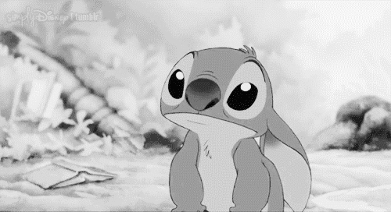
Listen!

Slide 21
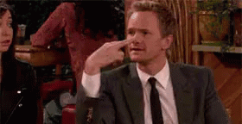
Look.

Slide 22
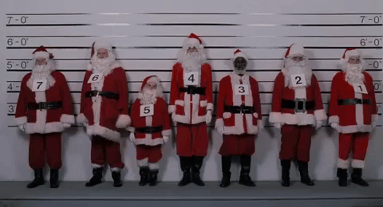
Line up.

Slide 23
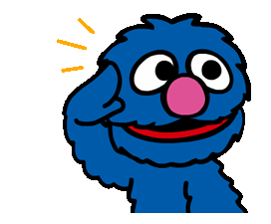
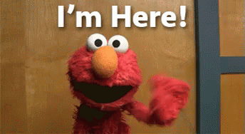
Repeat after me.
Say “I’m here!”

Slide 24
Stand up.

Slide 25
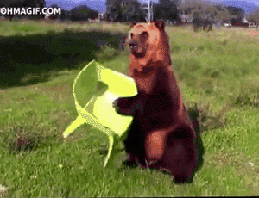
Sit down.

Slide 26
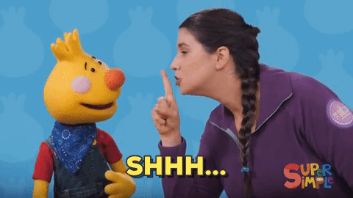
Be quiet, please.

Slide 27
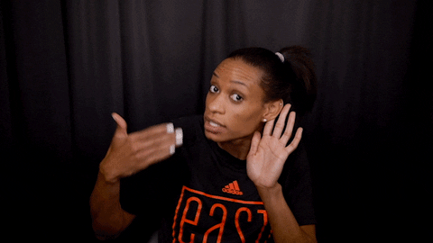
Louder, please.

Slide 28
1
2
3
4
Say “I’m here!”
5
6
7
8

Slide 31
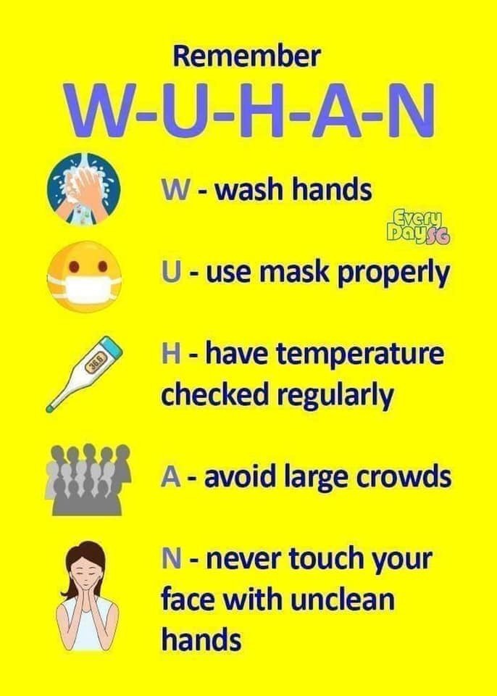

Slide 32
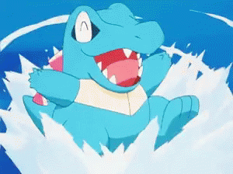
How are you?
I’m not so good.
I’m great!

Slide 33
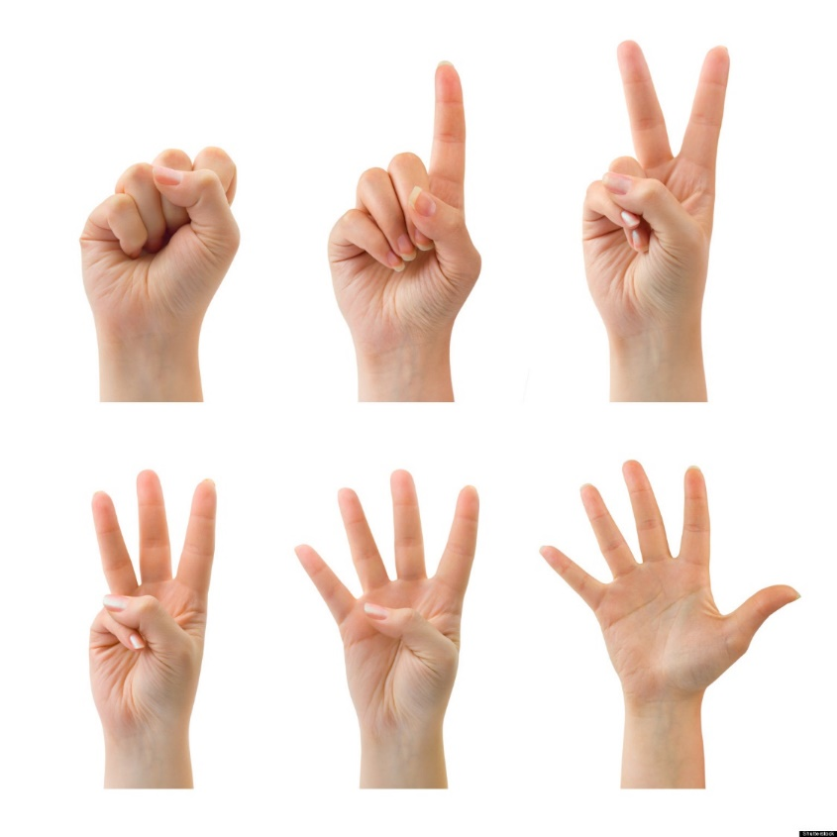
Let’s count!

Slide 34
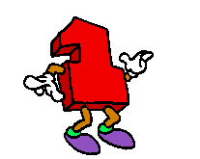
one

Slide 35
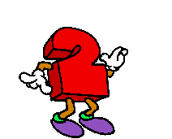
two

Slide 36
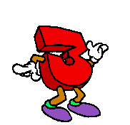
three

Slide 37
four

Slide 38
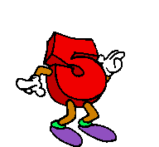
five

Slide 39
I have ……
one Pikachu

Slide 40
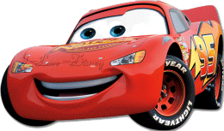
I have ……
two cars

Slide 41
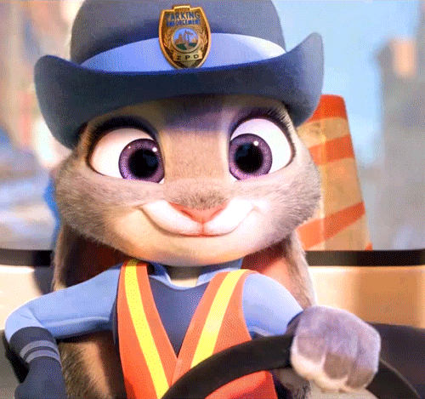
I have ……
three bunnies

Slide 42
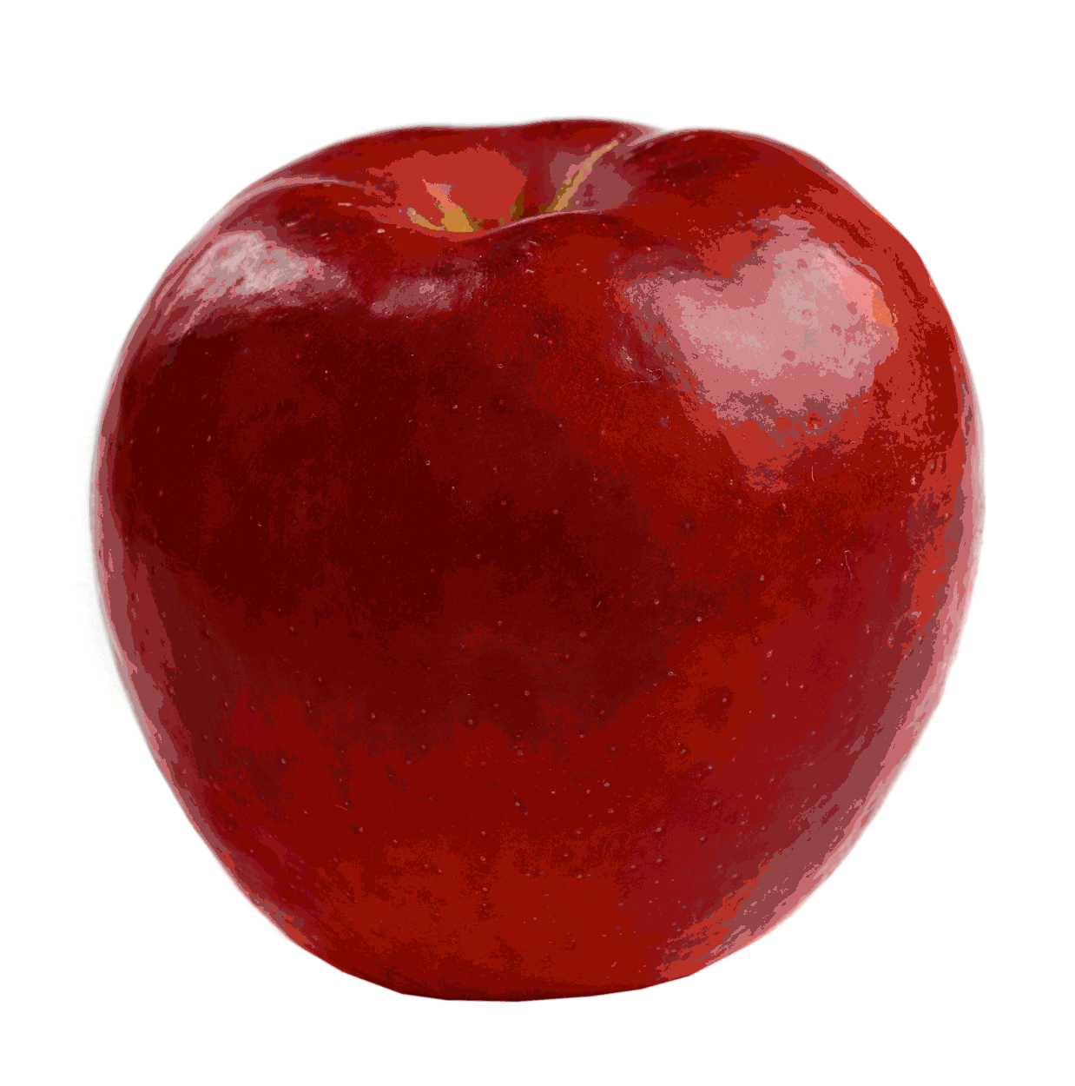
I have ……
four apples

Slide 43
I have ……
five cats

